Slide 1
Analysis of Branch Predictor Choices and their Impact on Performance of 8086 Microprocessor using Gem5 Simulator
Team Members:
Rubina Parveen (RXL220014)
Neha Gangalapudi (NXG220043)
Allocate Marks ( 100/100)

Slide 2
Initial Set-Up
For this Project we have used Gem5 installed on the UTD Server.
Copied the Gem5 to our Local Directory using the command: “cp –rf /usr/local/gem5/home/010/r/rx/rxl220014/CA/gem5
Compiled using the command: “scons build/X86/gem5.opt”.
After Compiling, we cloned the Benchmark Files to our local directory using the command provided: “git clone https://github.com/timberjack/Project1_SPEC.git”.

Slide 3
Branch Predictor
A branch predictor is a crucial component of a pipelined CPU that helps improve its performance.
It works by attempting to anticipate the address of a branch instruction well in advance and with limited context, organizing the most likely outcome.
Despite having access to only the current instruction's address and a limited history, the predictor operates before the decoder pipeline phase.

Slide 4
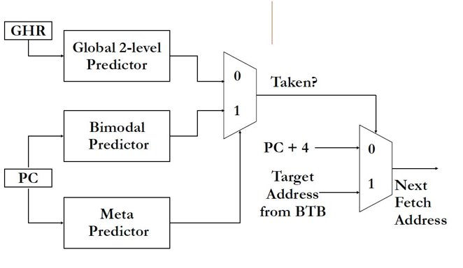
Types of Predictors Used
Tournament Predictor: It improves the accuracy of predictions by using a combination of two or more other branch predictors.
Uses a meta-predictor to determine which of the branch predictors should be used for each branch instruction. The meta-predictor compares the accuracy of the predictions made by the different predictors and selects the one with the highest accuracy for each branch.
This approach can provide higher prediction accuracy than any individual predictor alone.

Slide 5
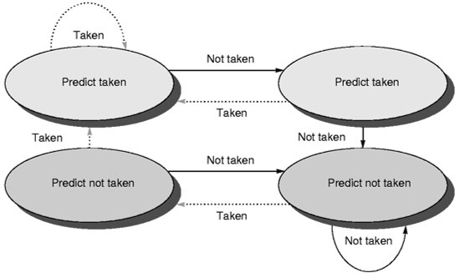
Local Predictor: Makes a prediction depending on the outcome of a branch for its last ten executions.
Stores a table of the history of branches at each location and uses this information to make predictions.
Local predictors work well when a program has repeating patterns of branches at specific locations.

Slide 6
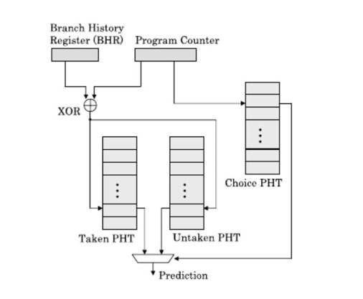
Bi-mode Predictor: It is a hybrid of local and global predictor. The bi-mode predictor uses a local predictor to predict the outcome of branches at specific locations in the program and a global predictor to predict branches that do not have a history at the current location.
The global predictor uses a history buffer to store the history of recent branches in the program and uses this information to make predictions.
The bi-mode predictor selects either the local or global predictor based on the history of recent branches at the current location in the program.

Slide 7
Project Requirements and Specifications
Objective
To Simulate different branch predictors over different benchmarks and observing their behavior hierarchy in X86 architecture on Gem5 simulator .
Tools Used
Gem5 simulator on the university server
MobaXterm: For remote SSH extension to access Gem5 over university server
Benchmarks: (1)401.bzip2 (2) 429.mcf (3) 456.hmmer (4) 458.sjeng (5) 470.lbm
Branch Predictors: (1) LocalBP( ) (2) TournamentBP ( ) (3) BiModeBP( )
Shell Script: Created a shell script project2.sh for the project

Slide 8
Deliverables
Changes made to source files.
Observing the changes made.
Generating the BTBMissPct and BranchMispredPercent for all Benchmarks
Varying the sizes of predictor and calculating the same for TournamentBP
Graphs of each benchamark for each Branch Predictor
Observations from the graphs.

Slide 9
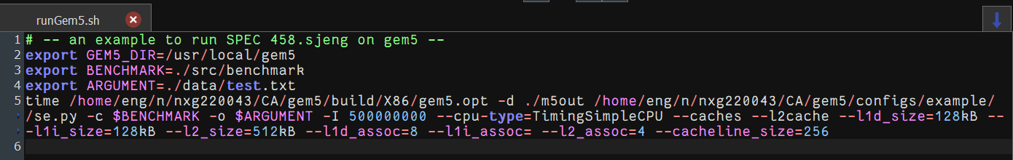
Changes in Gem5
We made the following changes to the respective “runGem5.sh” files for the Benchmarks 401.bzip2, 429.mcf, 456.hmmer, 458.sjeng and 470.lbm
Change the Argument path in every benchmark
Change the path of the gem5 directory

Slide 10
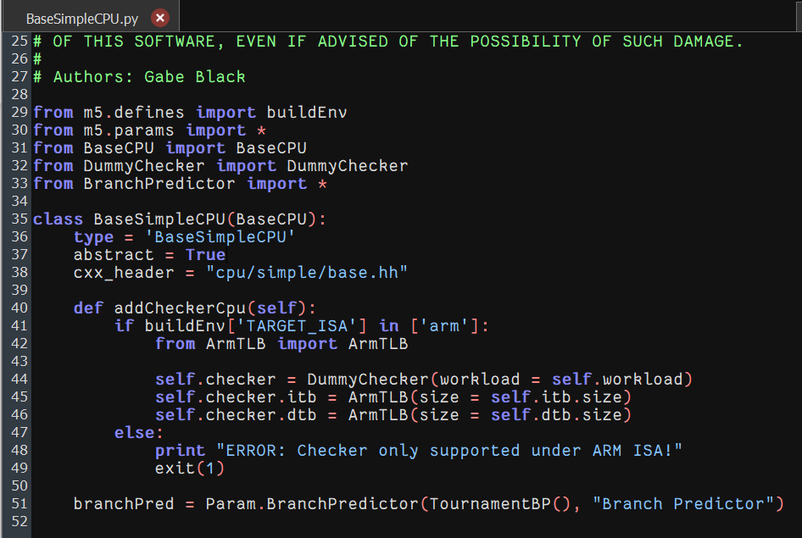
In the Gem5 folder, to change the branch predictor type
Go to cd gem5/src/cpu/simple .
Edit the file named “BaseSimpleCPU.py” and at the bottom we find the line: branchPred = Param.BranchPredictor (NULL, “Branch Predictor”)
In place of null we put the branch predictor types given: 1. LocalBP 2. BimodeBP 3. TournamentBP.
After changing each BP, delete all the files gem5/build/X86 first and then use the scons (% scons build/X86/gem5.opt) command to recompile in order to reflect the changes.

Slide 11
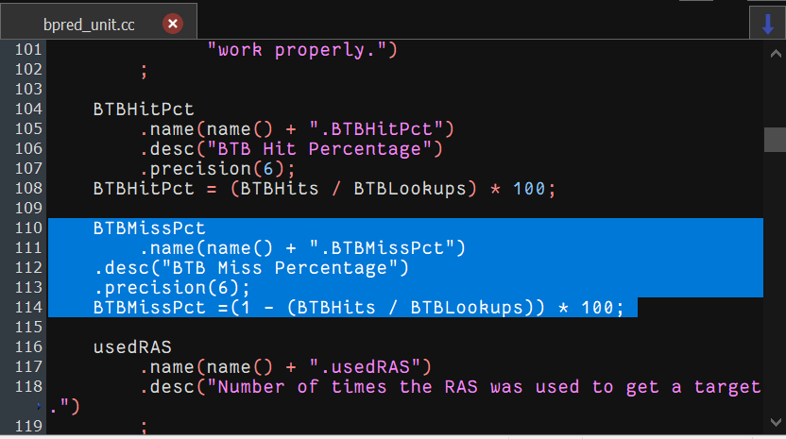
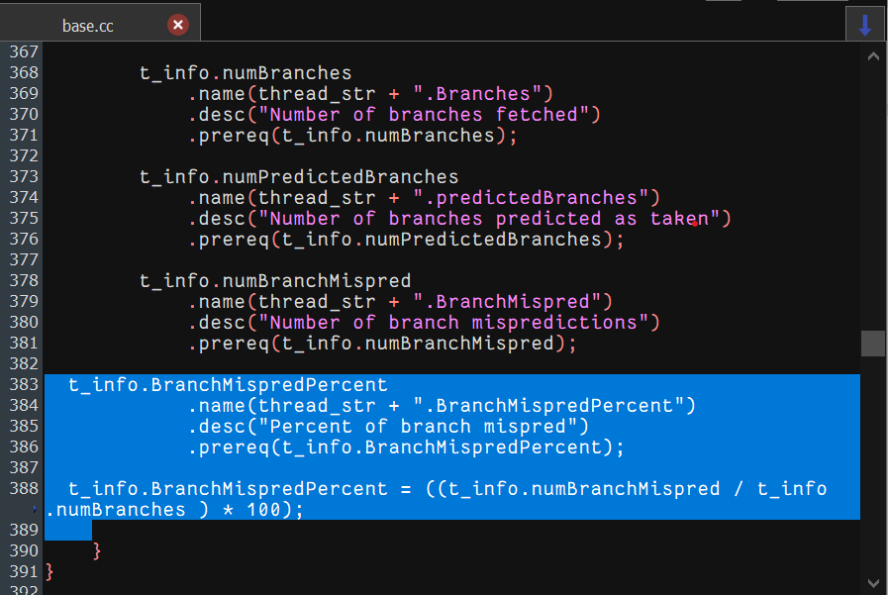
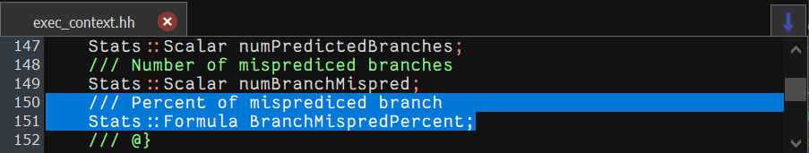
Changes to source files
Changes in bpred_unit.cc file for adding the definition of BTBMissPct
Changes in base.cc file for definition of BranchMispredPercent
Changes in exec_context.hh file

Slide 12
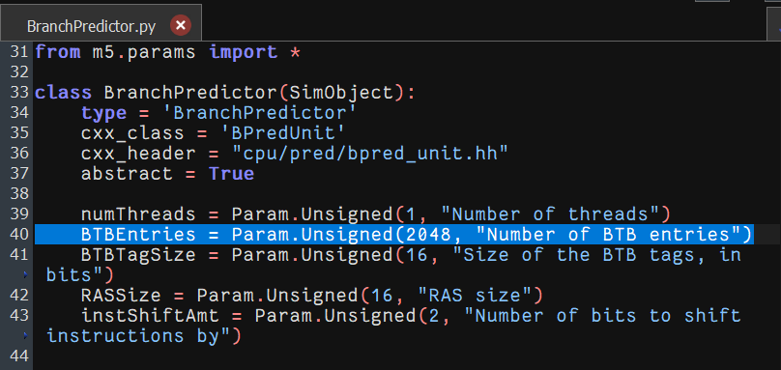
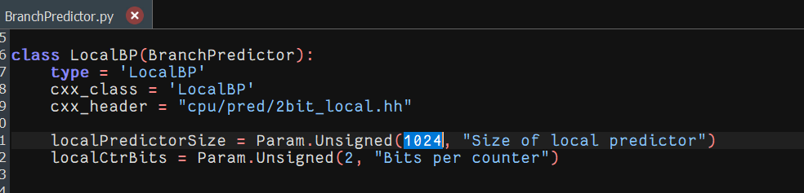
We make following changes in sizes of the predictor in gem5 in file: gem5/src/cpu/pred/Branchpredictor.py
In class BranchPredictor : Number of BTB entries is changed .
In class LocalBP: Size of local predictor is changed

Slide 13
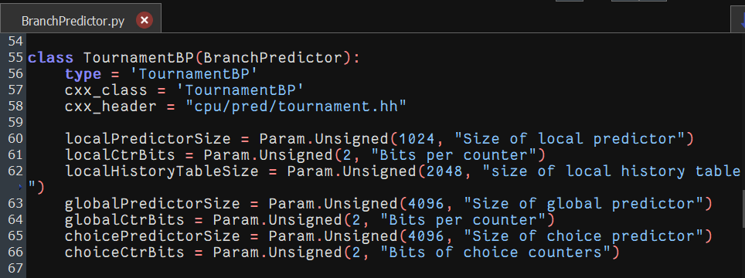
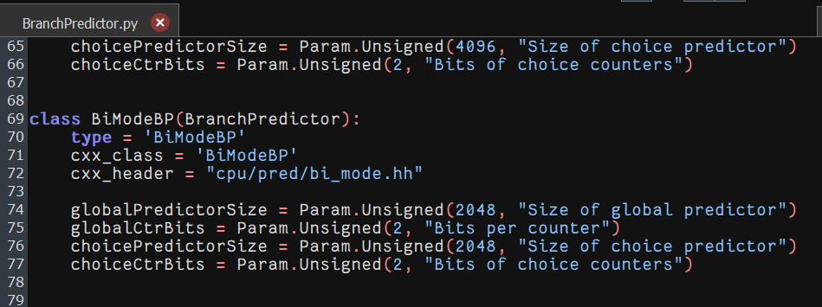
In class TournamentBP: localPredictorSize, globalPredictorSize and choicePredictorSize are changed
In class BiModeBP: globalPredictorSize and choicePredictorSize are changed

Slide 14
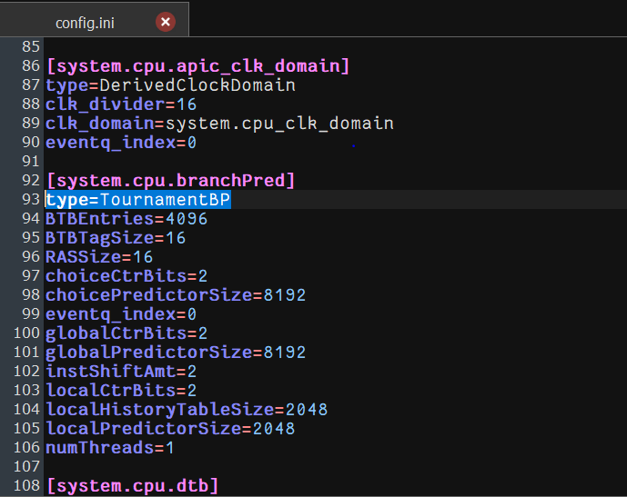
Outputs to be observed after compiling
After making the necessary changes we run the script for all the benchmarks, for all the three Branch Predictors separately and compare the results for different Branch Predictors.
Then in m5out/config.ini file of every benchmark, we observe if the type of system.cpu.pred is the same as the predictor we have changed.

Slide 15
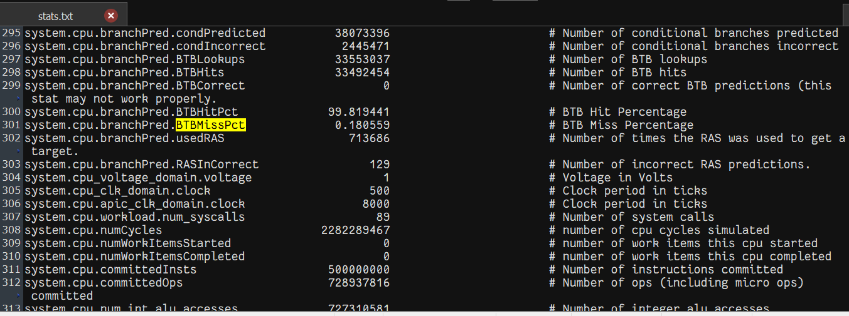
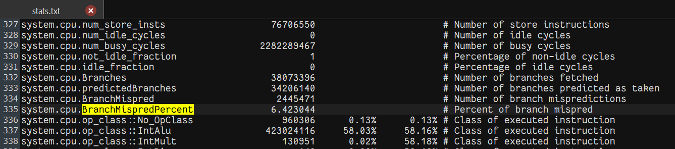
We can find the results in our m5out/stats.txt file of every benchmark

Slide 16
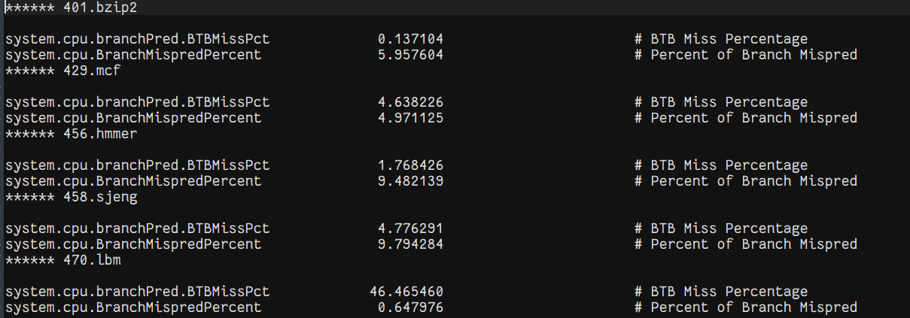
We made a file branchpred.txt where all the outputs that we need are captured and stored of all benchmarks in a single file.

Slide 17
BTB Miss Pct of all Benchmarks for all types of Predictor

Slide 20
Branch MispredPercent of all benchmarks for all types of predictors.

Slide 23
Observations & Conclusion
From the graphs obtained we can say that for the given combination of branch predictor sizes the BiMode BP is giving the least BTB miss percentage for benchmarks 401.bzip2, 429.mcf, 456.hmmer and 470.lbm and Tournament BP is giving least BTB miss percentage for 458.sjeng.
The best result we obtained for benchmark 401.bzip2 : Branch Predictor-BiMode BP, BTB miss percent = 0.135964, BTB Entry = 2048 and Predictor size = 2048.
The Tournament BP is giving the least branch miss prediction percentage for 429.mcf, 456.hmmer, 458.sjeng, for 401.bzip2 it is BiMode BP and for 470.lbm it is Local BP.
The best result we obtained for benchmark 470.lbm : Branch Predictor-Local BP, Branch miss percent = 0.595001, BTB Entry = 2048 and Predictor size: Local=1024, Global=4096, Choice = 4096.

Slide 24
Therefore, for the benchmark 401.bzip2 the best performance is achieved by BiMode BP with a BTB miss percentage of 0.135964 and a Branch miss percentage of 5.861087
For benchmark 429.mcf, we can choose BiMode BP as it is giving the least BTB miss percentage of 2.502616 and a Branch miss percentage of 5.637336.
We can choose BiMode BP for benchmark 456.hmmer as it is providing the best tradeoff between the BTB miss percentage and Branch Miss percentage when compared to Tournament BP. The BTB miss percentage by BiMode is 0.670678 and the Branch Miss Prediction percent is 9.482139.
For benchmark 458.sjeng the Tournament BP gives the best results with a BTB miss percentage of 4.776297 and Branch Prediction miss percentage of 9.794284.
Lastly for Benchmark 470.lbm, the best performance is with Local BP for the Branch Prediction Miss percentage, but it gives more BTB misses when compared to BiMode BP.
The BiMode BP outperforms the other two Branch Predictors for most of the benchmarks for the given specifications.

Slide 25
BTB MissPct values for all Benchmarks for Tournament Branch Predictor

Slide 26
Keeping the BTBentries value same and changing the sizes of Local Predictor (LP), Global Predictor(GP), Choice Predictor (CP) and observing the changes in BTB Miss percentage for all benchmarks using graphs.
As LP,GP & CP sizes increases, BTB MissPct decreases.
As LP,GP & CP sizes increases, BTB MissPct remains almost decreases.

Slide 27
As LP,GP & CP sizes increases, BTB MissPct decreases.
As LP,GP & CP sizes increases, BTB MissPct increases.

Slide 28
As LP,GP & CP sizes increases, BTB MissPct increases.

Slide 30
Branch Mispred Percentage for all Benchmarks for Tournament Branch Predictor

Slide 31
Keeping the BTB value same and changing the sizes of Local Predictor (LP), Global Predictor (GP), Choice Predictor (CP) and observing the changes in Percentage of Branch Miss Prediction for all benchmarks using graphs.
As LP,GP & CP size increases, Percentage of Branch Miss prediction decreases.
As LP, GP & CP size increases, Percentage of Branch Miss prediction decreases.

Slide 32
As LP, GP & CP size increases, Percentage of Branch Miss prediction decreases.
As LP, GP & CP size increases, Percentage of Branch Miss prediction decreases.

Slide 33
As LP,GP & CP size increases, Percentage of Branch Miss prediction decreases.

Slide 35
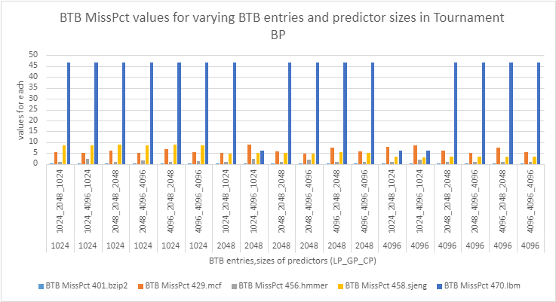
BTB Miss Percentage after changing the BTB entries

Slide 36
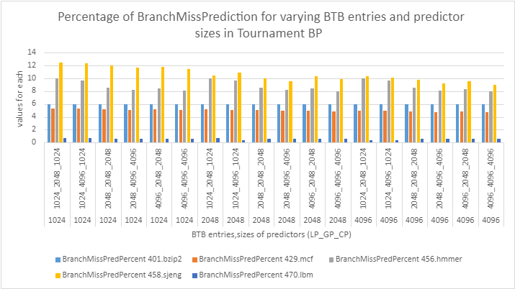
Branch Prediction Miss Percentage after changing the BTB entries

Slide 37
Observations & Conclusion
For the Tournament BP
We observe that as the sizes of the 3 predictors increase the BTB Miss percentage decrease for benchmarks 401.bzip2, 429.mcf, 456.hmmer and increases for 458.sjeng and 470.lbm if we keep the BTB Entries constant. Branch prediction miss percentage decrease if we keep the BTB Entries constant for all the 5 benchmarks.
If we change the BTB Entries and vary the 3 predictors sizes as well, we observe that as the BTB Entries size and the predictor sizes increase the BTB Miss percentage and the Branch Miss Prediction Percentage decreases.
We are getting the least BTB miss percentage for benchmark 401.bzip2 if we change both the BTB entries and predictor sizes and the lease branch miss predictions for benchmark 470.lbm.
But the Tournament BP can best perform for Benchmarks 401.bzip2 and 429.mcf, not for the other 3 benchmarks as it gives either BTB miss percentage too high, or the branch miss prediction percentage is too high.

Slide 38

Thank You

